Slide 1
MEBYF SOLAR ENERGY PROJECT
AUTONOMOUS PHOTOVOLTAIC SOLAR ENERGY project LOCATION: ESMERALDAS, canton MUISNE, PUERTO NUEVO-CONCEPCION (GUABINA, BREAK, BUENA VISTA) TOURIST CONNECTION RUTA DEL SOL UNIÓN ESMERALDAS, MANABI AND GUAYAQUIL

Slide 2
OBJECTIVES
PROVIDE AUTONOMOUS PHOTOVOLTAIC SOLAR ENERGY TO 85 FAMILIES OF THE COMMUNITIES IN THIS RURAL AREA OF ACTION.
WITH THE ASSEMBLY OF THE SOLAR ENERGY SYSTEMS ACCESS SOLUTIONS TO SUSTAINABLE ELECTRIC ENERGY WILL BE GIVEN.
ACCESS TO ENERGY IMPROVES EDUCATION, HEALTH, COMFORT, PROTECTION AND PRODUCTIVITY, FOR THE FAMILIES LIVING IN THE RURAL SECTOR.

Slide 3
MEMBERS OF THE RURAL PROJECT ESMERALDAS, MUISNE ECUADOR
MEBYF Development and Entrepreneurship, The Hague, The Netherlands Rosa Intriago Murillo, CEO of MEBYF and RI Consultancy
Delft University of Technology, Delft, The Netherlands, Department of Electrical Sustainable Energy Dr.ir. Mr. Jose Rueda, Associate Professor leading the research team on Stability, Control, and Optimization, within the Intelligent Electrical Power Grids Section
EASY Metering, Guayaquil, Ecuador Mr. Byron Rojas, CEO and Electric ir. Mr. Hector Morales
FIELDBERG, Financial Services, The Hague, The Netherlands Mr. Martijn van den Berg
PUERTO NUEVO Community representative and Project manager Mr. Angel Intriago Farias

Slide 4
INVESTIGATION:
THE COMMUNITIES AT THE PRESENT DATE DO NOT HAVE ACCESS TO ELECTRICAL ENERGY.
FAMILIES THAT ARE DEDICATED TO AGRICULTURAL AND LIVESTOCK WORK
ACCESS TO ELECTRICAL ENERGY ENABLES FAMILIES TO IMPROVE ECONOMIC HEALTH

Slide 5
LOCATION
ESMERALDAS PROVINCIA VERDE, LOCATED IN THE NORTH OF ECUADOR BATHED BY THE WARM WATERS OF THE PACIFIC OCEAN AND SURROUNDED BY PRIVILEGED FORESTS, SUCH AS THE ECOLOGICAL RESERVE SOUTH OF ESMERALDAS MACHE-CHINDUL, VERY CLOSE TO THIS SEA SECTOR, SAN FRANCISCO. ISLANDS, BEACHES, SEA. MUISNE, PUERTO NUEVO, TOURIST PLACES OF ECUADOR- RUTA DEL SOL.

Slide 6
PROJECT METHODOLOGY
IT IS AN AGILE PREDICTIVE PROJECT
FRIENDLY WITH THE ENVIRONMENT (SUSTAINABLE ENERGY)
LIFESTYLE IMPROVEMENT
FACILITATES COMMUNITY DEVELOPMENT

Slide 7
PROJECT ACTIVITIES
IMPLEMENTATION OF THE PROJECT
GEOREFERENCING
LIST OF BENEFICIARIES
PROFORMA KITS AND ACQUISITION OF REVISION KITS
TRANSFER OF EQUIPMENT
PRO FORM AND ACQUISITION OF STRUCTURES FOR FIXING KITS
REVISION AND RELOCATION OF STRUCTURES FOR FIXING
ASSEMBLY OF EQUIPMENT COMMISSIONING

Slide 8
FINANCING
ENGINEERING BUDGET
TECHNICAL REVIEW
PROFORM
INSPECTION
PURCHASE OF KITS OR EQUIPMENT AND SUPPORT STRUCTURES
METERS
MOBILIZATION
EQUIPMENT ASSEMBLY
COMMISSIONING
MAINTENANCE

Slide 9
PROJECT DETAILS

Slide 10
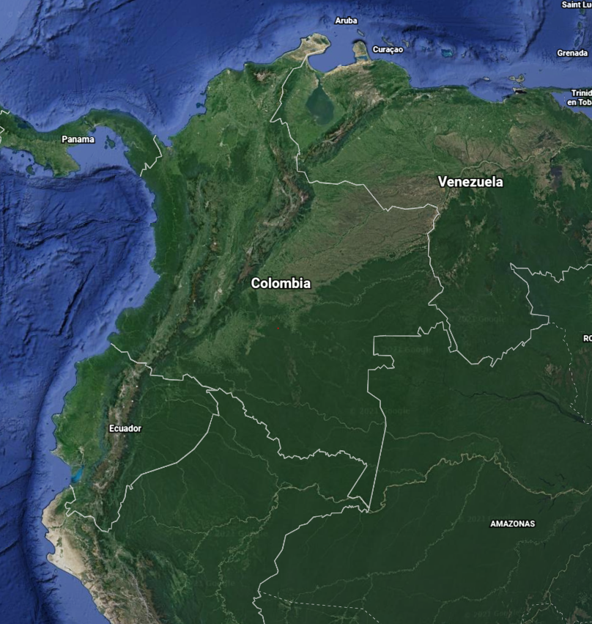
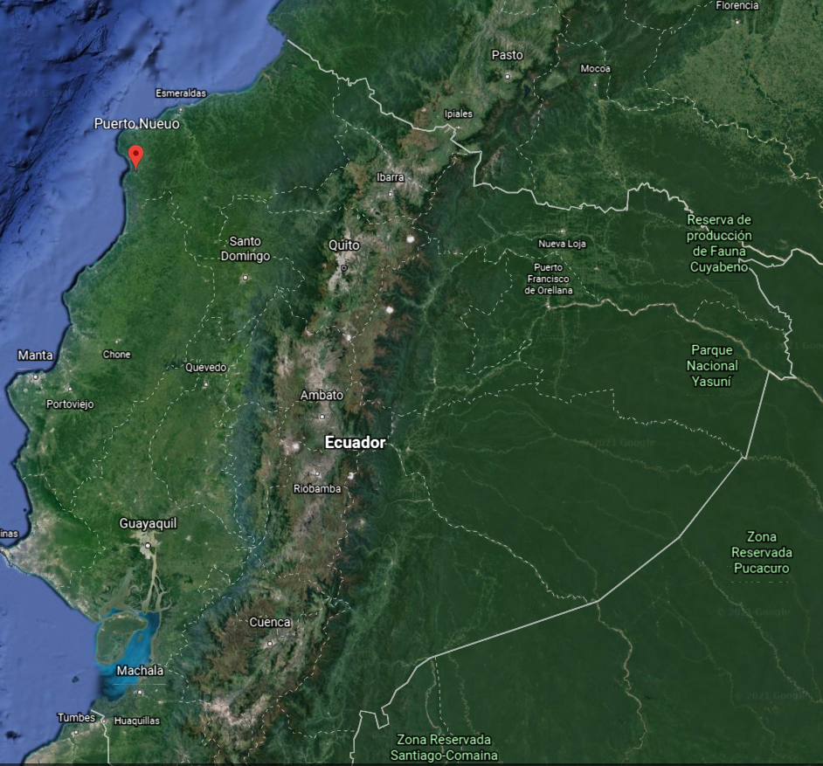
PROJECT LOCATION PUERTO NUEVO-CONCEPCIÓN MUISNE, PROVINCE ESMERALDAS, ECUADOR

Slide 11
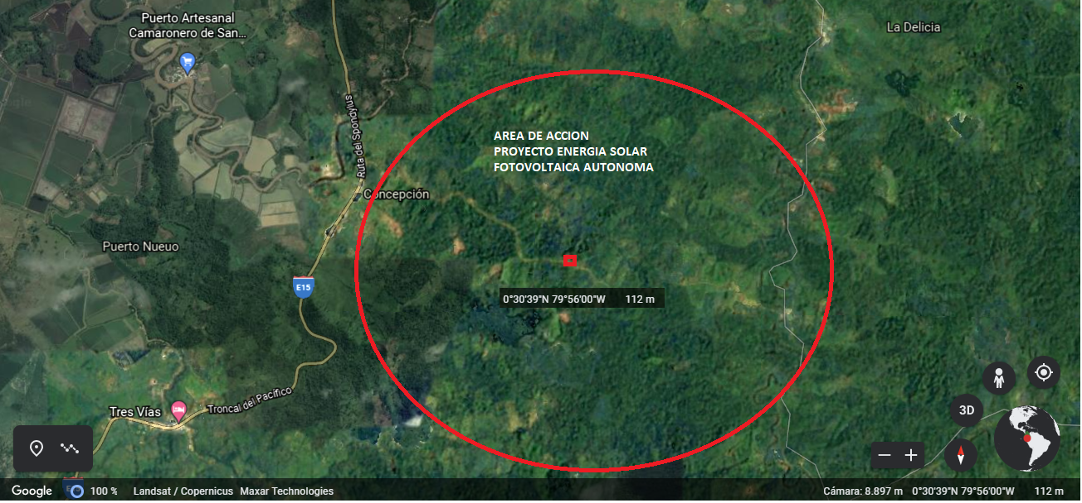
PROJECT IMPLEMENTATION RURAL AREA

Slide 12
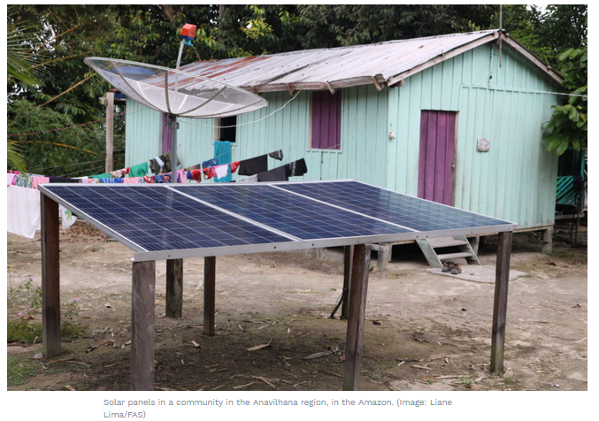
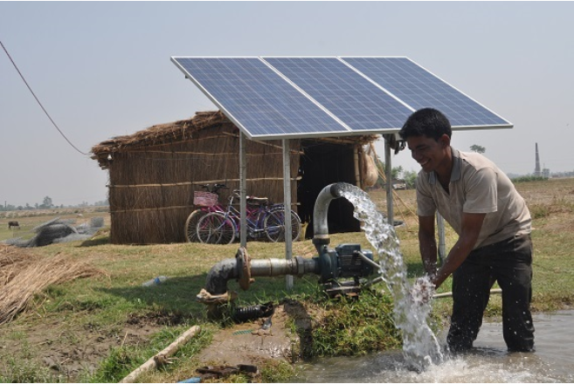
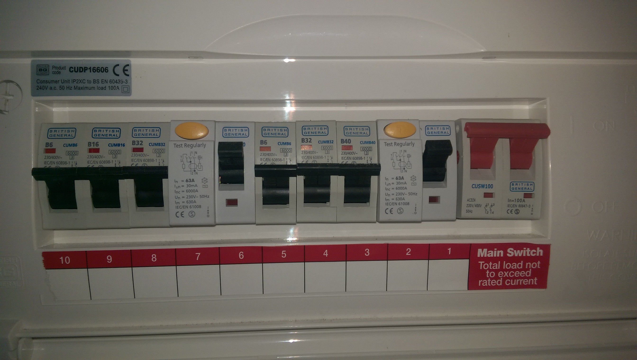
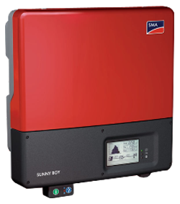
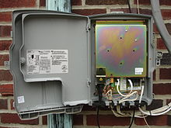
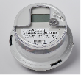
PROJECT IMPLEMENTATION INSTALLATION OF SOLAR PANELS IN RURAL COMMUNITY
Solar Panels
Energy Meter with remote monitoting
Houses
DC protection
Inverter
AC protection
DC Energy circuit
Source: https://www.giz.de/en/worldwide/73840.html
AC Energy circuit

Slide 13
SOLAR PANEL KIT

Slide 14
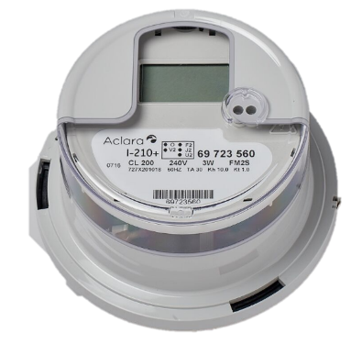
REMOTE ENERGY MEASUREMENT KIT
ELECTRONIC METER
Designed with multiple options to meet different utility needs whilst being a very cost effective solution. Plug-and-play capability for remote communication and management, with a wide range of compatible solutions 100-amp service switch below deck

Slide 15
ENABLED CUSTOMER BENEFITS
Solar panels provide clean energy.
Sustainable energy more respectful to the environment.
Photovoltaic energy comes from nature (infinite and abundant).
No diesel generated appliances
Photovoltaic energy obtains greater energy power in a more economically profitable way
The life cycle of a solar panel is guaranteed 25 years
Guarantee of availability of energy for a long period
Greater reliability with remote monitoring of metering and generated consumption
Proactive maintenance better assess the status of assets and plan necessary equipment replacements.
Planned replacements are faster (so outage is shorter) and cost fewer
Outage updates, and proactive outage notifications keep the customer informed quickly
Visibility of how the system is performing enables better detection of fluctuations in power generation and anticipate maintenance actions
Customers do not have to call to report problems in the generation
Customer Safety Identification of customer's heated outlets / panels using temperature data to assist with fire prevention; Determine outages caused by fires using temperature data.

Slide 16
REFERENTIAL BUDGET 1
REFERENTIAL BUDGET KIT'S OF PHOTOVOLTAIC SOLAR ENERGY PLANTS 3280W / DAY
PRICE WITH KIT (DOLLARS) | INSTALLATION OF C / KIT (DOLLARS) | BRACKET AND STRUCTURE ASSEMBLY FOR C / KIT (DOLLARS) | TRANSPORTATION OF C / KIT (DOLLARS) | AUDIT (DOLLARS) | TOTAL PRICE PER KIT (DOLLARS) | TOTAL USERS | STAGE I USERS 28 (DOLLARS) | STAGE II USERS 28 (DOLLARS) | STAGE III USERS 29 (DOLLARS) | TOTAL INVESTMENT (DOLLARS)
6200 | 550 | 1500 | 300 | 250 | 8025 | 85 | 247000 | 224700 | 232725 | 798212
Material or fiancial support it is very welcome for us. Thank you in advance.

Slide 17
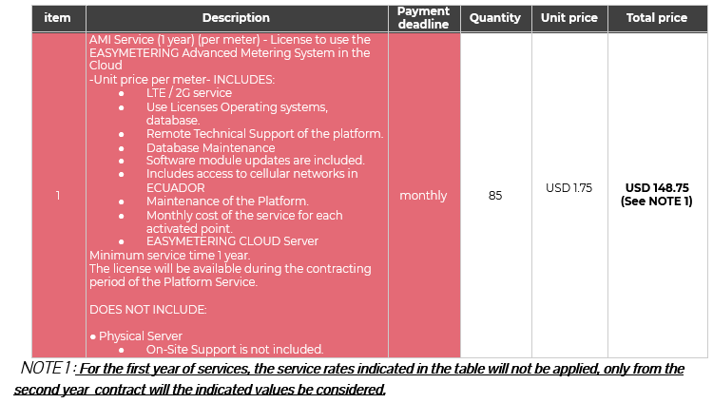
RERENTIAL BUDGET 2

Slide 18
FOUNDATION MEBYF Contact details
Address: Zandberglaan 25 The Hague, The Netherlands EMAIL: info@mebyf.com Telephone number: +31628272657 Bank details: Name: Stichting MEBYF Bank number: NL65INGB0008508563

Slide 19
BENEFICIARIES PHASE #1 sectores de guabina, rompe, buena vista
1. ÁNGEL ULPIANO INTRIAGO FARIAS 2. TITO VICENTE LOOR LEONES 3. ANTONIO SEBASTIÁN ZAMBRANO VERA 4. DUFFER OCTAVIO GODOY SÁNCHEZ 5. FERNANDO OLIVER NÚÑEZ BONILLA 6. HITURVIDE JULIÁN CHASIN GUAGUA 7. RICARDO ALFREDO PALMA RODRÍGUEZ 8. MANUEL ÁNGEL INTRIAGO MURILLO 9. FELICIANO VALENCIA CHILA 10. PEDRO PABLO RODRÍGUEZ ANCHUNDIA 11. MARIO FABIÁN SANTANA ANDRADE 12. DOLORES CARMEN SOLORZANO CEDEÑO 13. CIRILO ANTONIO SOLORZANO PINARGOTE 14. CECILIA ERMICENIA CHASIN GUAGUA 15. CARMEN ESTHER CHASIN GUAGUA

Slide 20
BENEFICIARIES PHASE#2 sectores de guabina, rompe, buena vista
16. BALDAMINA DEMESIA CHILA CHILA 17. EDDIE GERMÁN NÚÑEZ BONILLA 18. EDISON ENRIQUE MENDOZA MOLINA 19. NANCY MARÍA INTRIAGO VALENCIA 20. ESNERITA JANETH CHILA HERRERA 21. ANDRÉS SEBASTIÁN ZAMBRANO MERA 22. LISBETH ELIZABETH NÚÑEZ MENESES 23. JORGE ANTONIO ANDRADE OSTAIZA 24. DALICE RAMONA MENDOZA BRAVO 25. EDISON ARTURO ANDRADE PARRALES 26. DAVID ESLEIDER NÚÑEZ ESPÍN 27. PABLO MIGUEL CHILA LEÓN 28. MANUEL ERNESTO PALOMINO VERA 29. SISOY ANTONIO CABRERA CARRAZCO 30. JACINTA LASTENIA AVEIGA RODRÍGUEZ

Slide 21
BENEFICIARIOS PHASE#3 sectores de guabina, rompe, buena vista
31. SEGUNDO CAYETANO MOREIRA SACÓN 32. JESSICA ARACELY OLAYA AVEIGA 33. SEGUNDO DIEGO PADILLA 34. PERDOMO NÉSTOR RODRÍGUEZ ANCHUNDIA 35. MARINA JESÚS PATRÓN VALDES 36. JOSÉ ROBERTO QUIÑONES HERRERA 37. WILMER DECIDERIO PALACIO CALDERÓN 38. JULIO TAPUYO DELA CRUZ 39. NELSON ANTONIO VALDEZ MOLINA 40. MARÍA PIEDAD QUIÑONES HERRERA 41. LUIS JACINTO VALDEZ MOLINA 42. MONSERRATE JESÚS ROMERO SOLORZANO 43.RENÉ ANTONIO MOLINA ROMERO 44. DEYSY MARISOL QUIÑONEZ HERRERA 45. MARI LEONOR HERRERA ESCOBAR 46. LISSETTE QUIÑONEZ HERRERA 47. JORGE LEONARDO ZAMBRANO ESMERALDAS 48. JUANA BEATRIZ QUIÑONEZ HERRERA 49. BENITO ANTONIO SACON VALENCIA 50. BARTOLOMÉ QUIÑONEZ CHASING

Slide 22
BENEFICIARIES PHASE#4 sectores de guabina, rompe, buena vista
51. LUIS EUSEBIO DELA CRUZ 52. MANUEL VICENTE DE LA CRUZ MOREIRA 53. JULIO CESAR DE LA CRUZ MOREIRA 54. ÁNGEL GLEOBAN MOLINA ROMERO 55. BARBARA MOREIRA GARCÍA 56. JOSE VICENTE ALCIVAR MERO 57. LUIS ALBERTO MÁRQUEZ MOLINA 58. RIGOBERTO AVILIO BRAVO SOLORZANO 59. EMÉRITA MERCEDES ZAMBRANO MOLINA 60. HENRY ALFREDO ZAMBRANO MOLINA 61. ANGELA RAMONA VEAS DELGADO 62. RAMÓN ELIAS PALADINES ESTACIO 63. PEDRO ANTONIO PITA MERO 64. GRISMALDO VALDEZ MOLINA 65. WILSON ANTONIO ZAMBRANO FIGUEROA 66. MIRIAN DOLORES SOLORZANO ANDRADE 67. ÁNGEL RAMÓN SOLORZANO ANDRADE 68. RAMÓN ANTONIO VERGARA GARCÍA 69. SERGIO YAJAIRO ZAMBRANO JAMA 70. MANUEL JACINTO VELEZ PARRAGA

Slide 23
BENEFICIARIES PHASE#5 sectores de guabina, rompe, buena vista
65. WILSON ANTONIO ZAMBRANO FIGUEROA 66. MIRIAN DOLORES SOLORZANO ANDRADE 67. ÁNGEL RAMÓN SOLORZANO ANDRADE 68. RAMÓN ANTONIO VERGARA GARCÍA 69. SERGIO YAJAIRO ZAMBRANO JAMA 70. MANUEL JACINTO VELEZ PARRAGA 71. DEYSY ROXANA ZAMBRANO JAMA 72. GLADYS MARÍA VERGARA GARCÍA 73. DAVID FRANCISCO PARRAGA VÉLEZ 74. SEGUNDO MANUEL RAMOS CHILA 75. BENIGNO RAYMUNDO REYNEL CHEME 76. MARIA JOSÉ RESABALA VERGARA 77. DAMIÁN FELIPE PARRAGA VELEZ 78. FELIPE TRINIDAD PARRAGA SOLORZANO 79. ROSA MARÍA VERGARA GARCÍA 80. MARTHA MARIA APARIZO PINEDA 81. CARLOS ANTONIO MEDRANDA SUARZ 82. MARCOS JUAN NONE GONGORA 83.MARLON MARIO APARICIO GONSALEZ 84.JUAN MANUEL MAURO APARACIO 85. CARLOS ALBERTO ROBLES VERA

